Slide 1
Sync Squad
Facial Image Recognition in Distributed Machine Learning using Rich Clients
CECS 574
Jaimin M Vyas
(031604298)
Aniket B Patel
(032180497)
Arjun B Vaghasiya
(032166509)
Yagnik K Beladiya
(030821490)

Slide 2

What is Distributed Computing? Why it is necessary?
Imagine you have a big puzzle to solve. Instead of one person working on it alone, you divide the puzzle pieces among a group of friends. Each friend works on their part of the puzzle simultaneously. When everyone finishes their part, you combine all the pieces to complete the puzzle much faster than if one person had done it alone.
Distributed computing is a model in which components of a software system are shared among multiple computers to improve efficiency and performance.

Slide 3
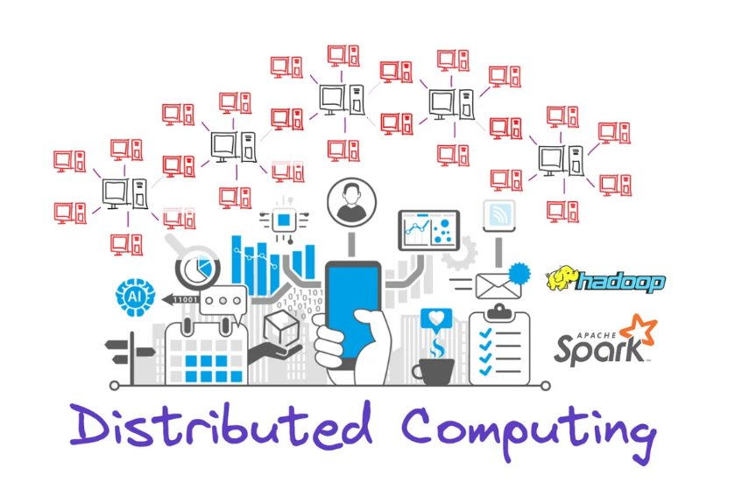
More Formal Way of Understanding DC
These computers communicate and coordinate their actions by passing messages to one another, working together to achieve a common goal. This approach allows for better resource utilization, increased reliability through redundancy, and the ability to scale systems by adding more computers to the network.
Key aspects of distributed computing include:
Concurrency: Multiple computers execute tasks simultaneously.
Scalability: The system can easily grow by adding more computers.
Fault tolerance: The system can continue functioning even if some components fail.
Transparency: The complexity of the system is hidden from the end-user, who interacts with it as if it were a single computer.

Slide 4
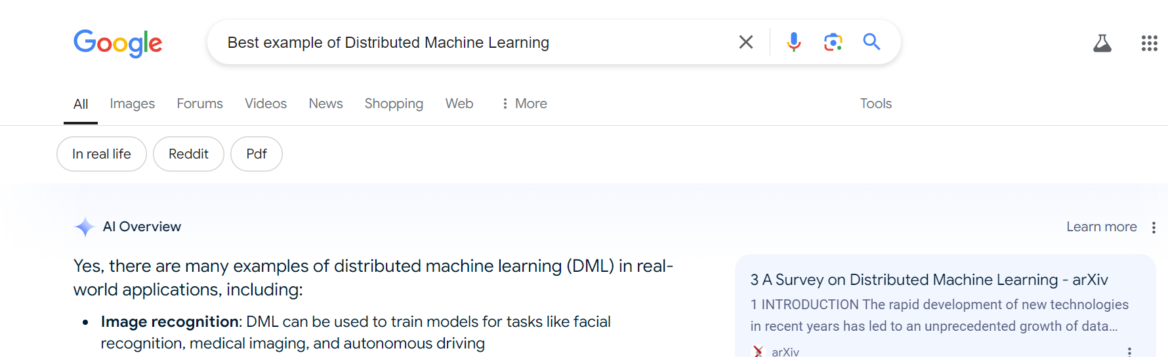
How a distributed Machine Learning work?
Distributed deep learning is used when we want to speed up our model training process using multiple GPUs

Slide 5
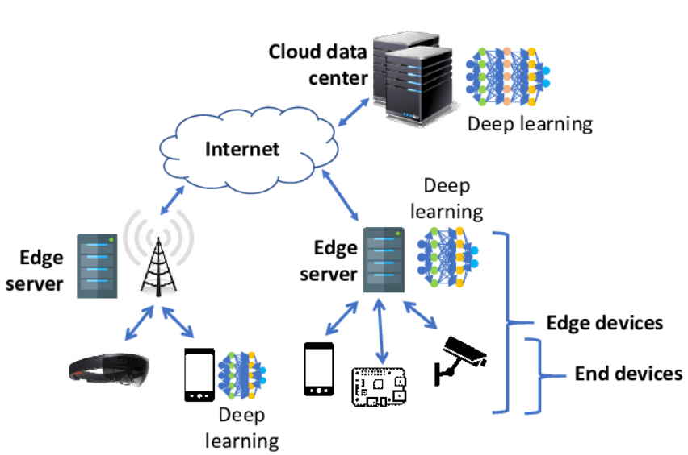
Facial Image Recognition in Distributed Machine Learning using Rich Clients
What are Rich Clients?
Refer to edge devices with high-performance computing capabilities
Eg: Smartphones, Smart home devices

Slide 6
What does this Research solve?
The need to process increasing amounts of data generated by edge devices
Privacy concerns in traditional cloud-based and edge computing models
High communication costs in existing models

Slide 7
How do the paper proposed to Solve the problem?
Only checkpoint files (containing training weights) are shared with edge servers, not raw data.
Edge devices can use results immediately and also benefit from further training on edge servers.

Slide 8
Paper's Implementation
Experimental Setup
Dataset: Labeled Faces in the Wild (LFW)
Edge Server: High-performance computer
Edge Device: Jetson Nano (representing future IoT devices)
Key Benefits
Enhanced privacy protection: Sensitive data remains on edge devices
Reduced communication costs: Only small checkpoint files are transferred, not large datasets
Improved accuracy through collaboration between edge devices and servers

Slide 9
Key Findings
The model achieved good accuracy while protecting privacy
Communication costs were significantly reduced
Edge devices could maintain high accuracy for personal data while benefiting from general training on edge servers
Significance:
This approach addresses growing concerns about data privacy (e.g., GDPR compliance) while leveraging the increasing computational power of edge devices to create a more efficient and privacy-preserving distributed machine learning system.

Slide 10
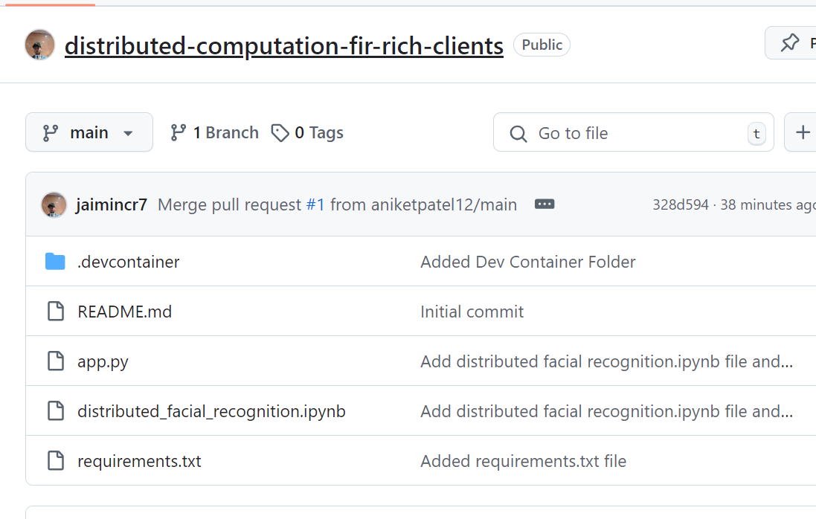
How did we Implemented the concept?
Implemented the whole logic into a "ipynb" file.
Used Dask Library, to implement the distributed computing.
Deployed it through app.py

Slide 11
Implementation
Started with the Dask library.
Extracted the LFW Dataset, from Google Collab space.
read_pairs() function for pairing the like images in a category.
Seperate Train and Test pairs of images.
compute_embeddings_batch() function for converting the images > list (for indexing) > vector embeddings.

Slide 12
Implementation
Defining a batch_size = 256 #depending on the compute powers used.
Storing the trained embeddings in embeddings_dict = {}.
compute_similarity() function to compute embeddings distance with the simillar embeddings of images.
plot_image_pair() function is proving the cosine similarity between 2/More different facial images.

Slide 13
Implementation
Lastly plot_confusion_matrix() function pukes out all the details of the model, for which particular Simillarity | Dis-Simillarity matrix.
Also it plots the graph of how the training and testing accuracy react with different hyper-parameter.
But the main catch here was Parellel training using Dask Library.

Slide 14
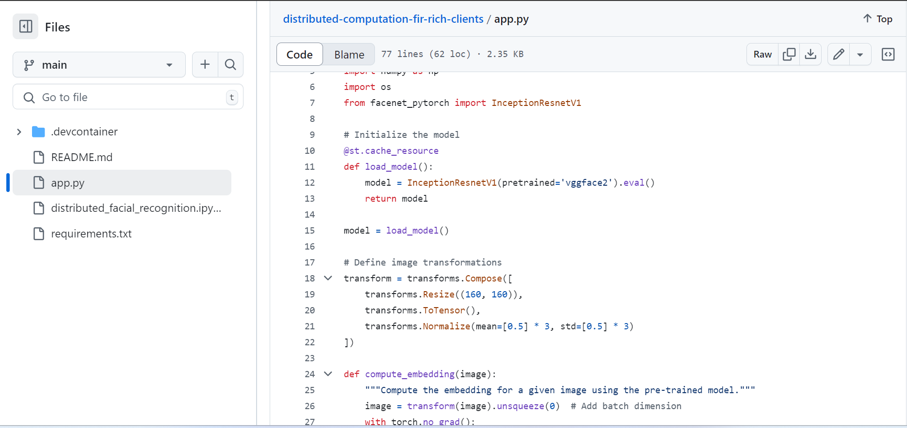
Distribution Strategy
Application has a functionality that will output the Cosine similarities between 2 Facial Image vectors.

Slide 15
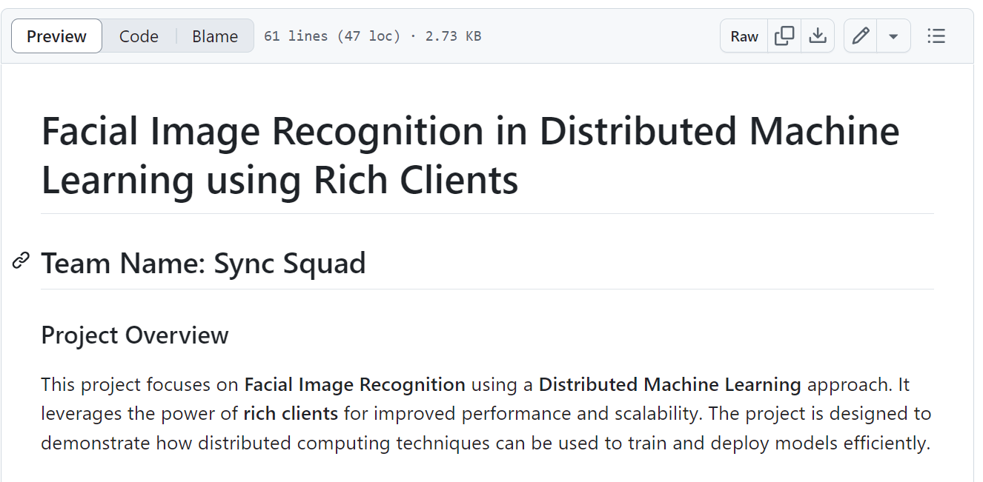
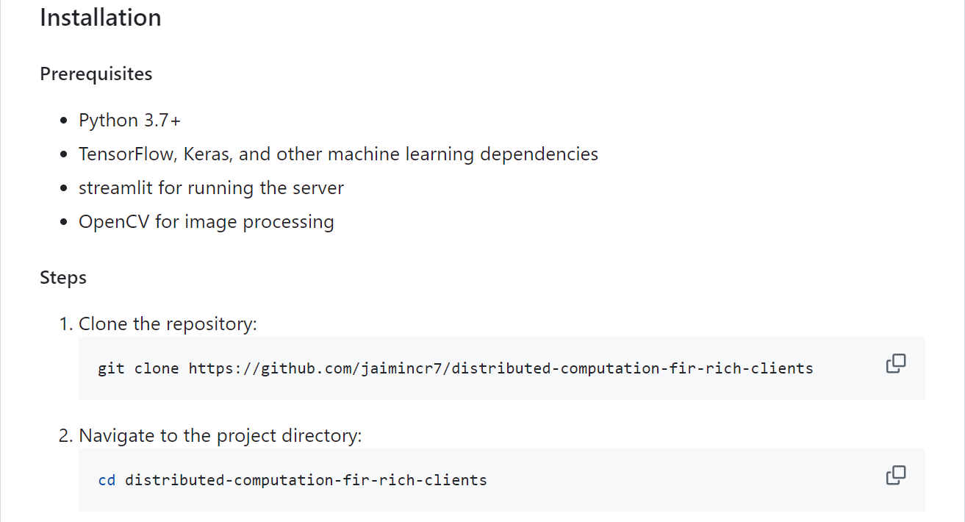
More Details
Link:
(https://github.com/jaimincr7/distributed-computation-fir-rich-clients/blob/main/README.md)

Slide 16
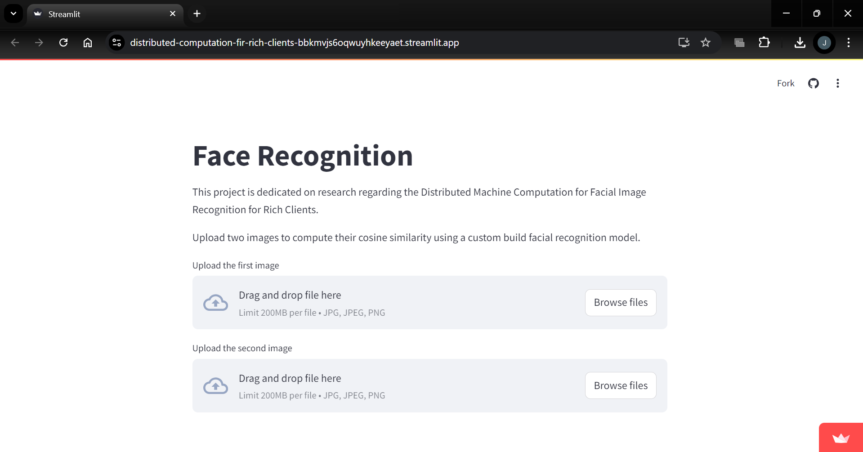
Deployment
Deployed on Streamlit:
(https://distributed-computation-fir-rich-clients-bbkmvjs6oqwuyhkeeyaet.streamlit.app/)

Slide 17
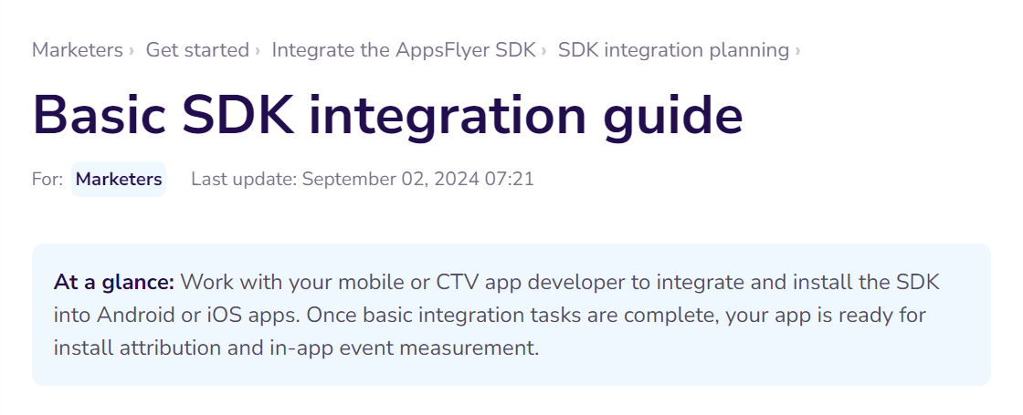
Future Expansion
Building SDKs / APKs around the app.py file, in order to let the community use the plugins on various Edge Devices (Rich Clients).

Slide 18
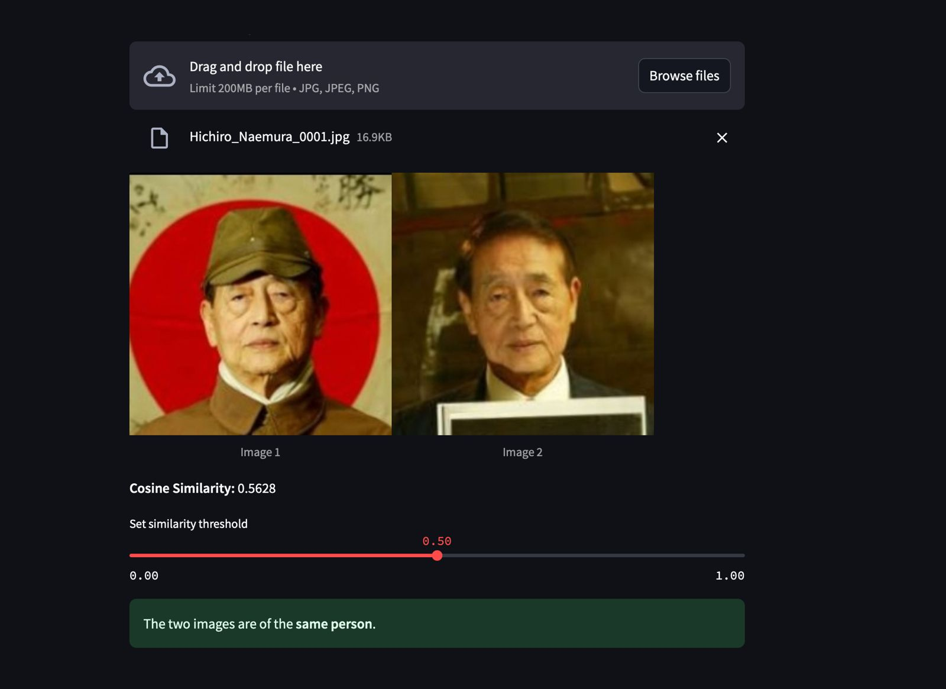
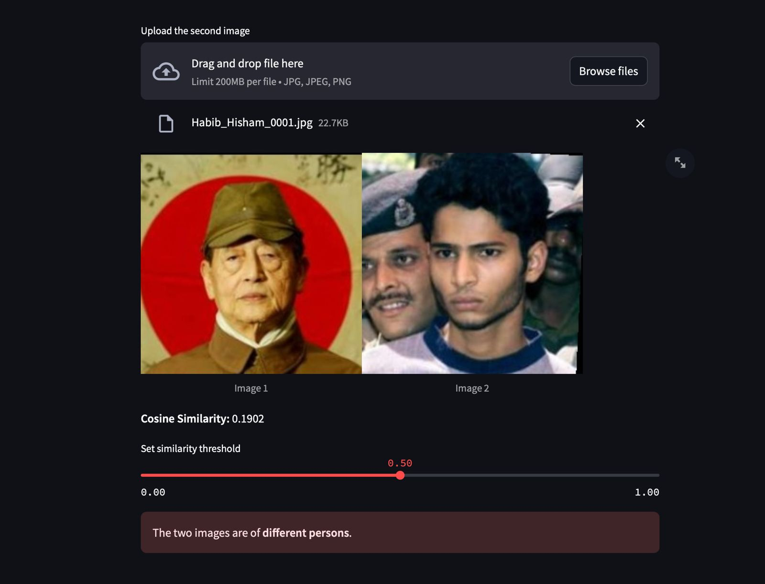
Outcomes
Same Person
Different Person

Slide 19
A Big Thank You!
Any Questions?

